Slide 1
計概報告 Data Structures
第3組
組員:李博茗、陳厚愷、葉倫峻、卓湘庭、
王柏凱、蘇冠名、洪翊庭

Slide 2
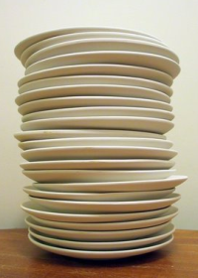
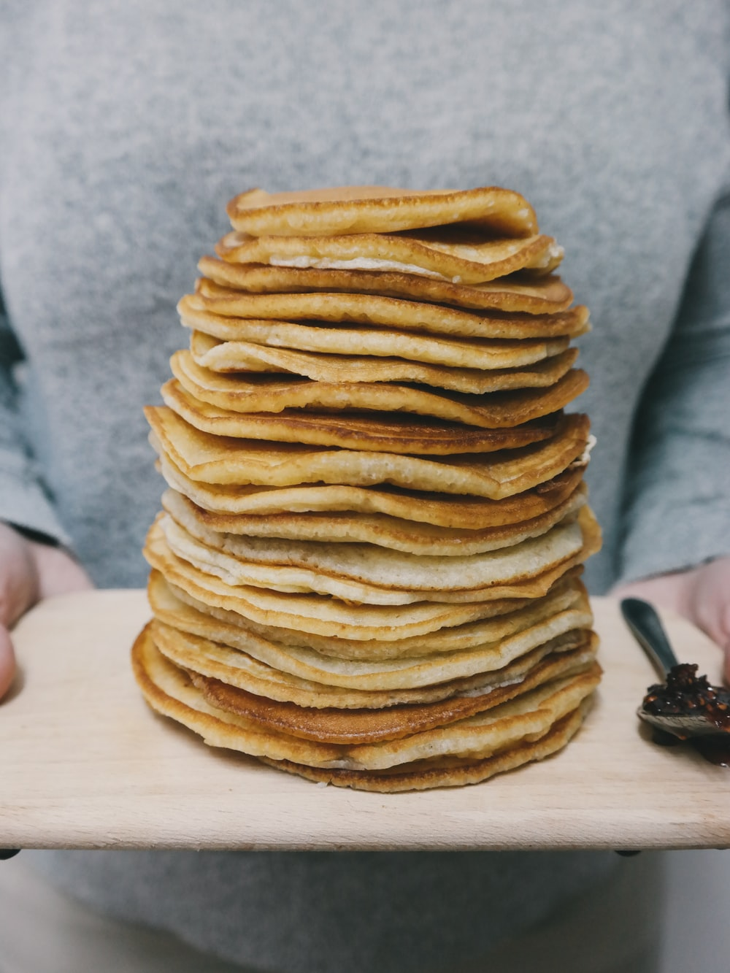
Stack
Notes:
一疊盤子或書的圖片

Slide 3


Stack

Slide 4
FILO
First In Last Out
Notes:
介紹FILO

Slide 5
Why using Stack?
FILO
Efficient to push/pop data

Slide 6


Pointer of stack
Push()
stack
Pop()

Slide 7
STL stack
top()
pop()
push()
empty()
size()

Slide 8
Usage of Stack
Function call
Recursion problem
Depth-first search(DFS)

Slide 9
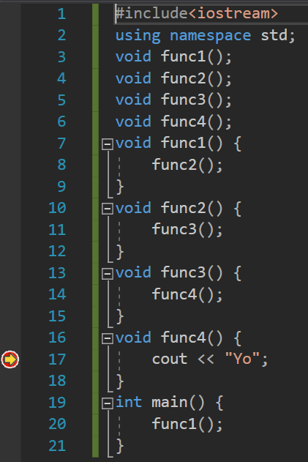
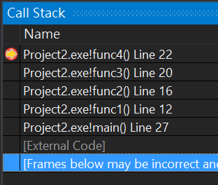
Function call

Slide 10

What’s “stackoverflow”
Answer programming questions
Notes:
沒有空格

Slide 11
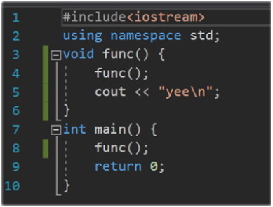
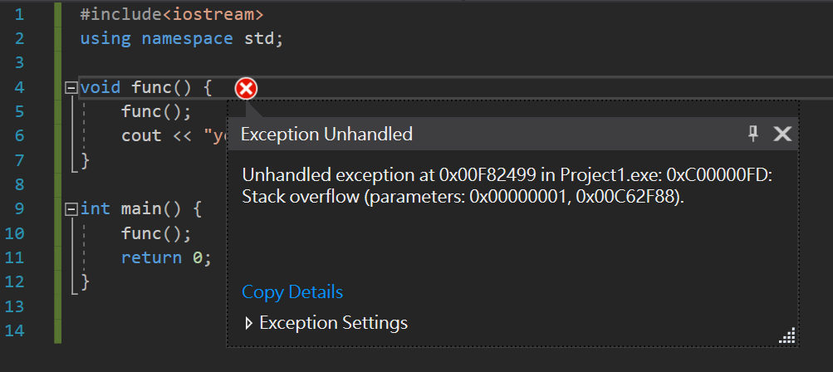
I meant “Stack overflow bug”
Calling too many functions
Mostly because infinite recursion

Slide 12
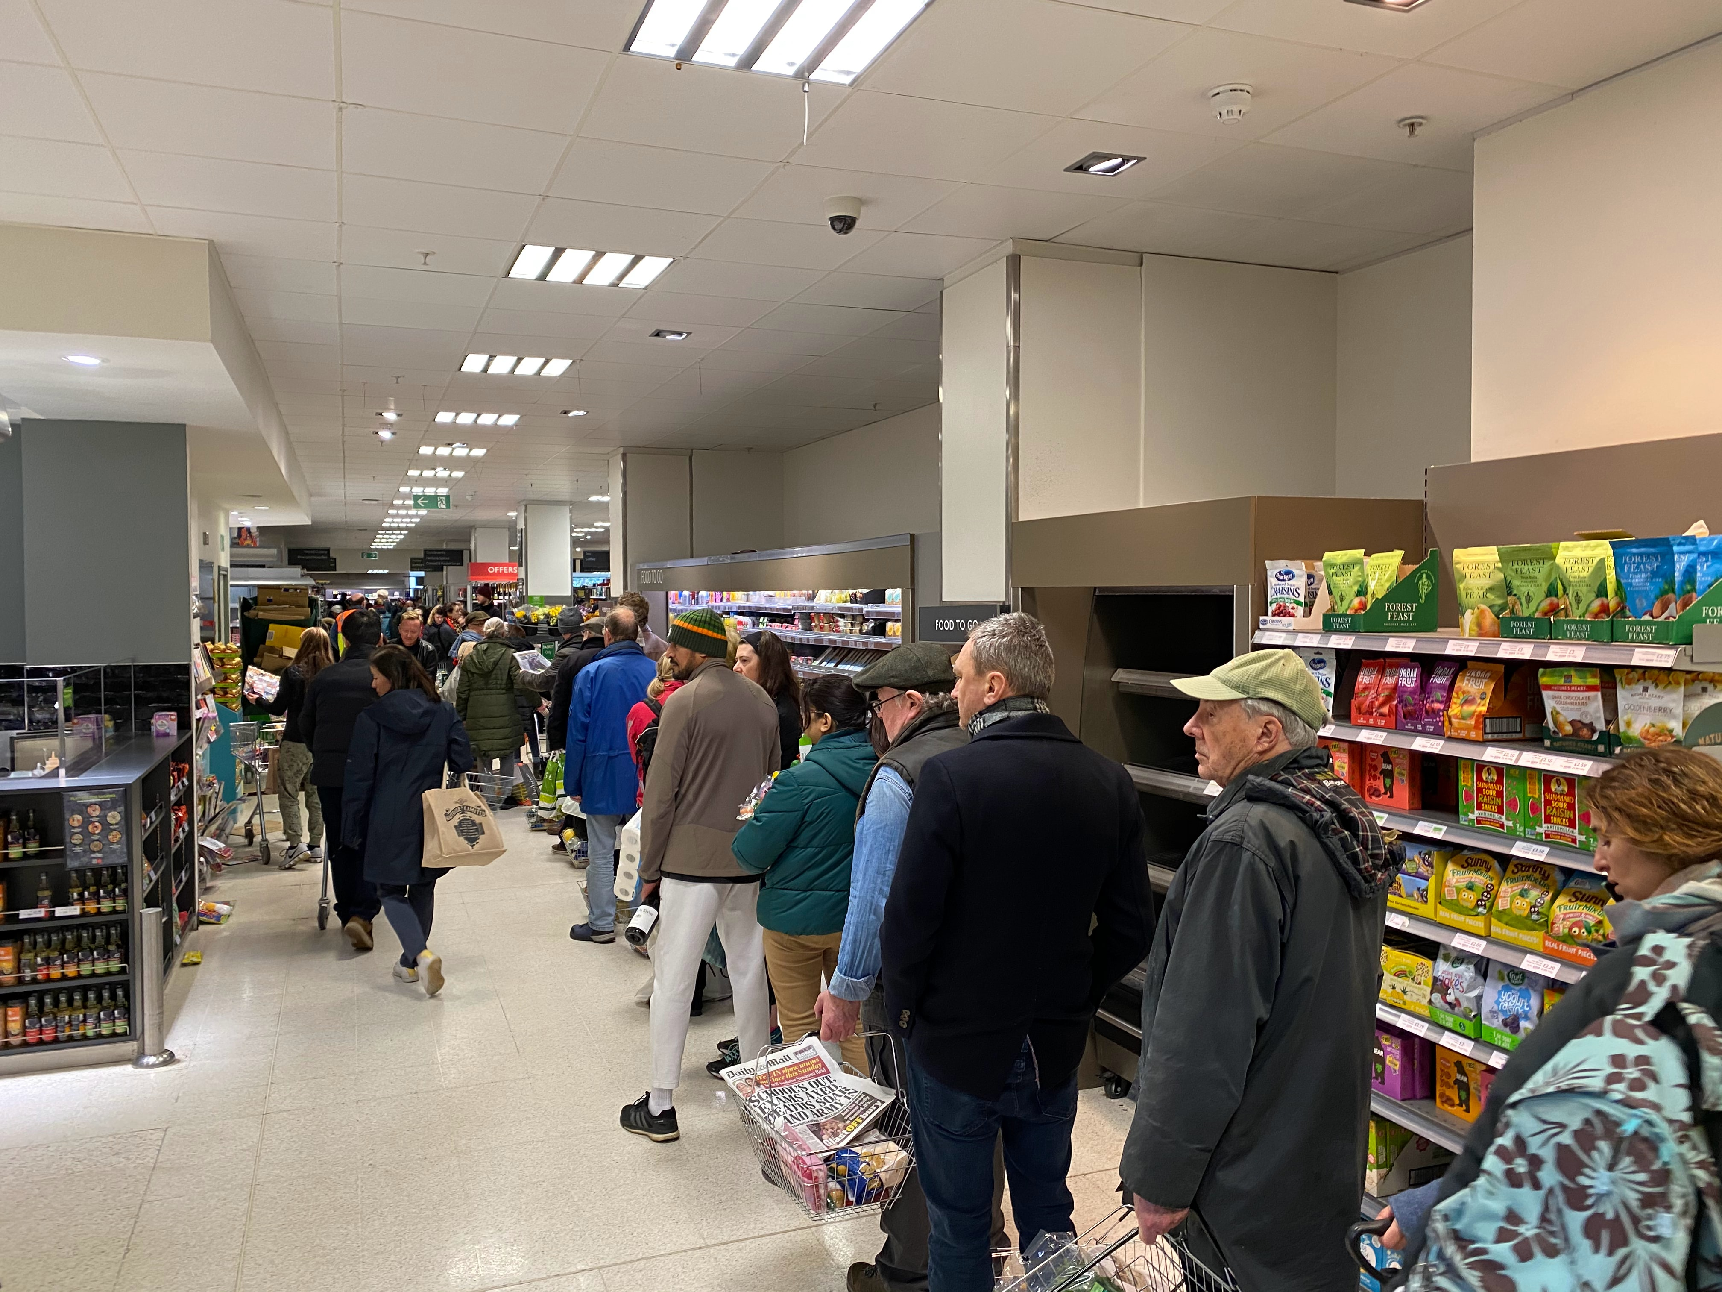
Queue

Slide 13
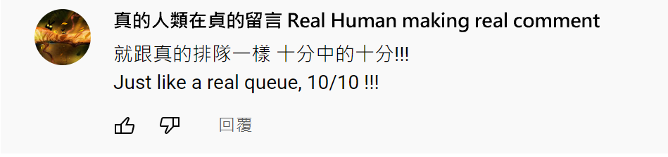
User feedback

Slide 14
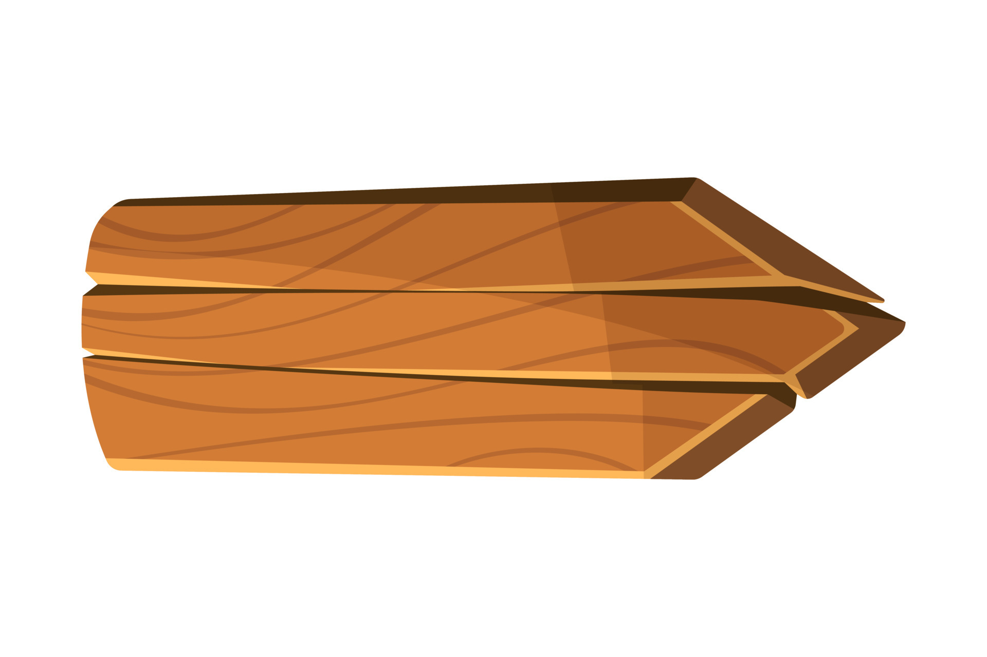



Queue
Free Food ->

Slide 15
FIFO
First In First Out
Notes:
介紹FIFO

Slide 16

Pointer of queue
Pop()
Tail
Head
Push()
Notes:
Head and tail pointer

Slide 17
STL queue
front()
pop()
push()
empty()
size()

Slide 18
Usage of queue
Allocating resources
BFS(Breadth First Search)

Slide 19
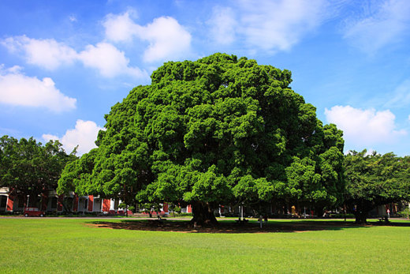
Tree

Slide 20
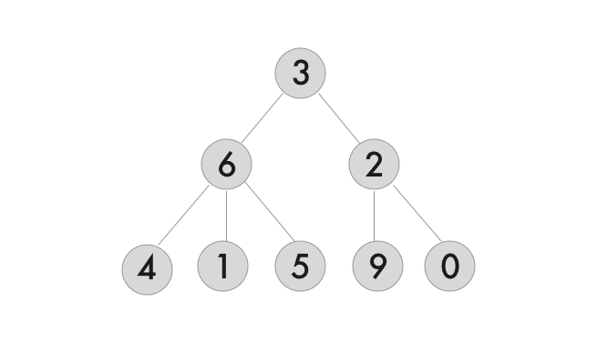
Also Tree
Hierarchical
Node
Data
Pointers

Slide 21



Comparison

Slide 22
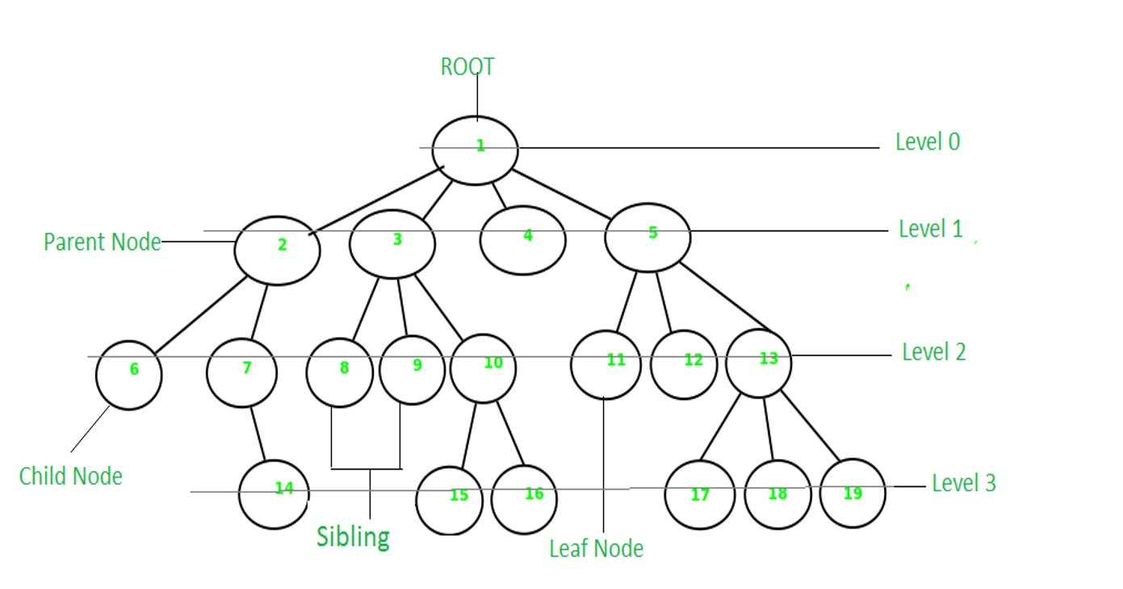
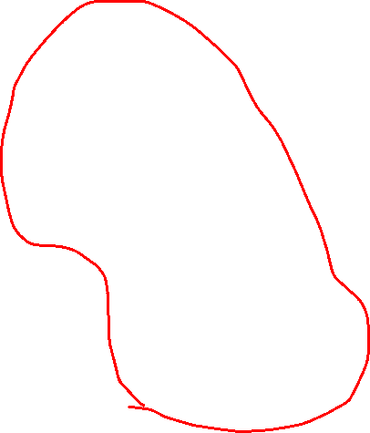
Terms
Height:3
Subtree

Slide 23
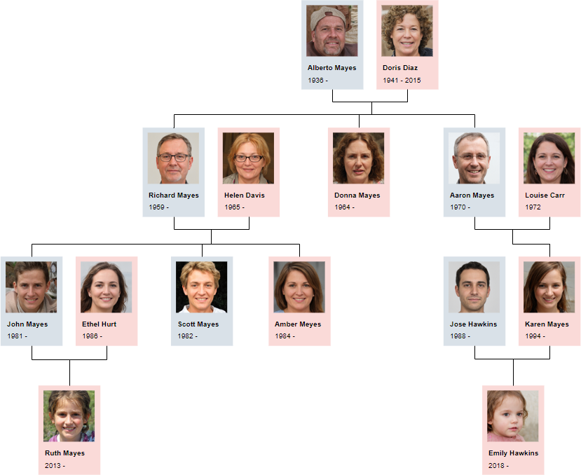
Why use tree?
Organized in a hierarchical way
Moderate search time
Moderate insert/delete time
Notes:
https://www.geeksforgeeks.org/applications-of-tree-data-structure/

Slide 24
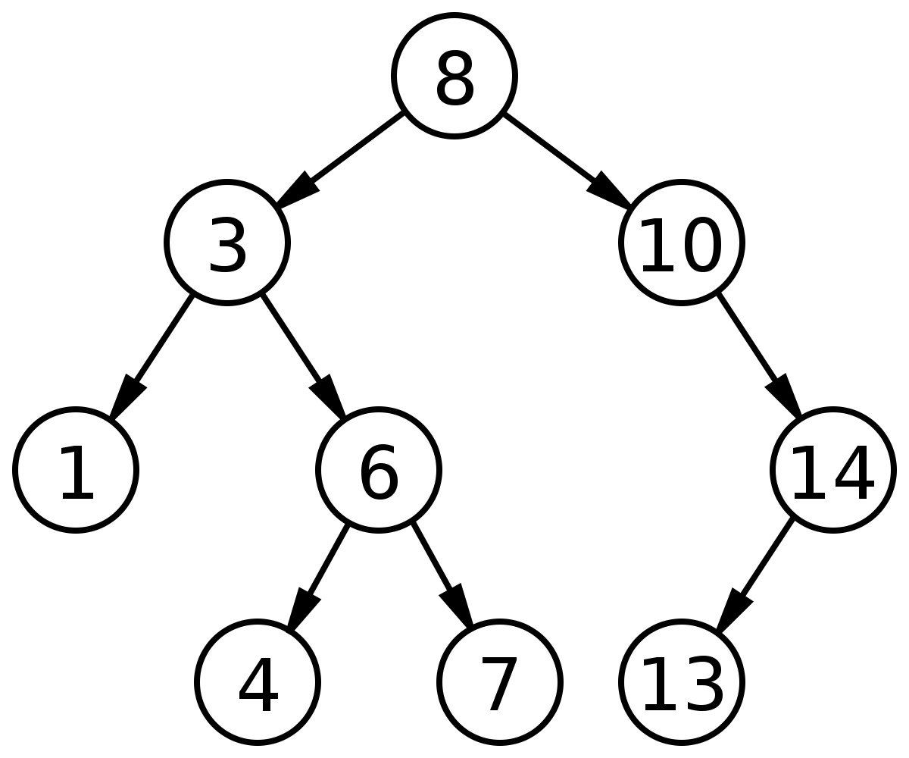
Binary Tree
Left and right child
Binary Search Tree(BST)

Slide 25
Binary Search Tree
Every value is unique
Left values are smaller
Right values are bigger

Slide 26
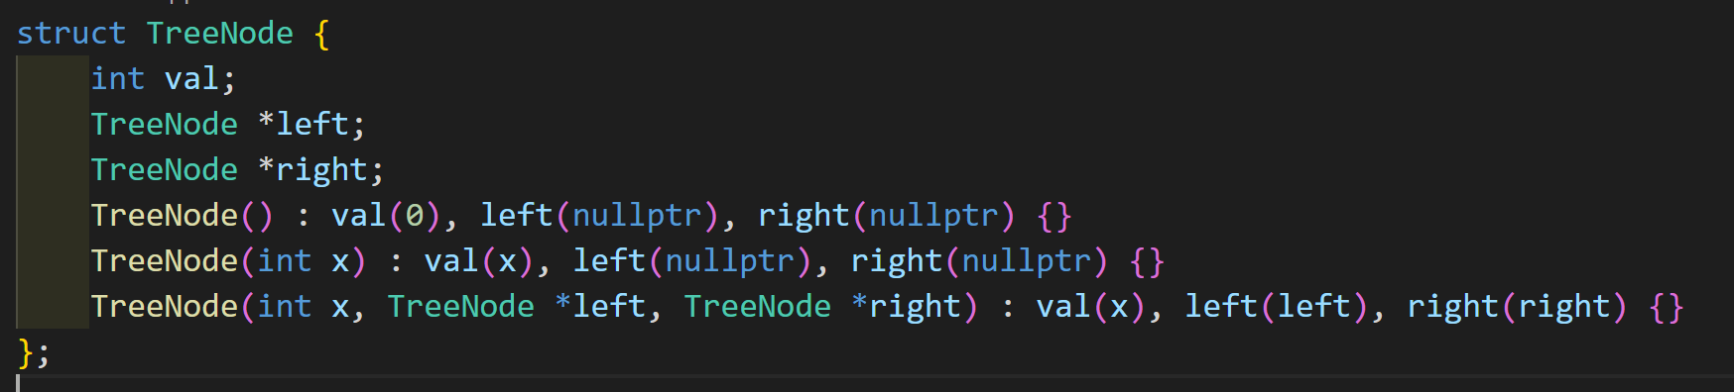
Implement Tree Node

Slide 27
How to search a tree
Start from root
Go to left/right child
Check leaf

Slide 28
BFS(Breadth First Search)
Push root into queue
While(queue is not empty){
Pop node
Push children of node into queue
}

Slide 29


BFS

Slide 30
BFS

Slide 31
DFS(Depth First Search)
Push root into stack
While(stack is not empty){
1. Pop node
2. Push children of node into stack
}

Slide 32
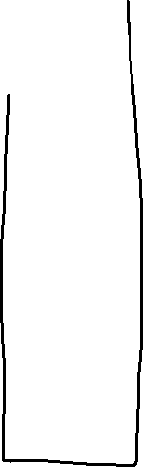
DFS

Slide 33
DFS

Slide 34
Traversing a tree
Visit every node in tree
Order of left/right subtree, root
3 Ways

Slide 35
Inorder
Left -> Root-> Right
Sequence: 1 3 4 6 7 8 10 13 14
From small to big value

Slide 36
Preorder
Root-> Left -> Right
Sequence: 8 3 1 6 4 7 10 14 13

Slide 37
Postorder
Left -> Right -> Root
Sequence: 1 4 7 6 3 13 14 10 8

Slide 38
Summary
Arrays
Linked lists
Pointer
Stack
Queue
Tree

